Slide 1

Computer Architecture
Course Code: CSE360
Lecture - 4
Cache Memory

Slide 2
Memory Hierarchy
Registers
  In CPU
Internal or Main memory
  May include one or more levels of cache
  “RAM”
External memory
  Backing store

Slide 3

Memory Hierarchy - Diagram
Decreasing cost per bit
Increasing capacity
Increasing access time
Decreasing frequency of access of the memory by the processor
Faster access time, greater cost per bit
Greater capacity, smaller cost per bit
Greater capacity, slower access time

Slide 4
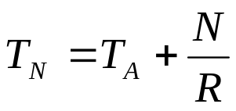
Performance
Access time
  For random access memory, the time it takes to perform a read or write operation, i.e. time between presenting the address and getting the valid data
  For non-random access memory, access time is the time it takes to position the read-write mechanism at the desired location
Memory Cycle time
  Consists of access time plus any additional time required before a second access can commence.
  Time may be required for the memory to “recover” before next access
  Cycle time = access time + recovery
Transfer Rate
  Rate at which data can be moved into or out of a memory unit.
  For random access memory, it is equal to 1/(cycle time)
  For non-random access memory,

Slide 5
Physical Types
Semiconductor
  RAM
Magnetic
  Disk & Tape
Optical
  CD & DVD
Others
  Bubble
  Hologram

Slide 6
Physical Characteristics
Decay, Volatility, Erasable, Power consumption
In a volatile memory, information decays naturally or is lost when electrical power is switched off.
In a non-volatile memory, information once recorded remains without deterioration until deliberately changed; no electric power is needed to retain the information.
Magnetic-surface memories are non-volatile.
Semiconductor memory may be either volatile or non-volatile.
Non-erasable unit cannot be altered except by destroying the storage unit. Semiconductor memory of this type is known as read-only memory (ROM); must be also non-volatile.

Slide 7
Organisation
For random-access memory, the organisation is a key design issue
Organisation means physical arrangement of bits to form words
Not always obvious

Slide 8
Hierarchy List
Registers
L1 Cache
L2 Cache
Main memory
Disk cache
Disk
Optical
Tape

Slide 9

Cache
Cache memory gives the fastest memory and at the same time provides a large memory size at the price of less expensive types of semiconductors memories.
Sits between normal main memory (slower and relatively larger) and CPU
May be located on CPU chip or module
The cache contains a copy of portions of main memory.
When the processor attempts to read a word of memory, a check is made to determine if the word is in the cache. If so, the word is delivered to the processor. If not, a block of main memory consisting of some fixed number of words is read into the cache and then it is delivered to processor.

Slide 10
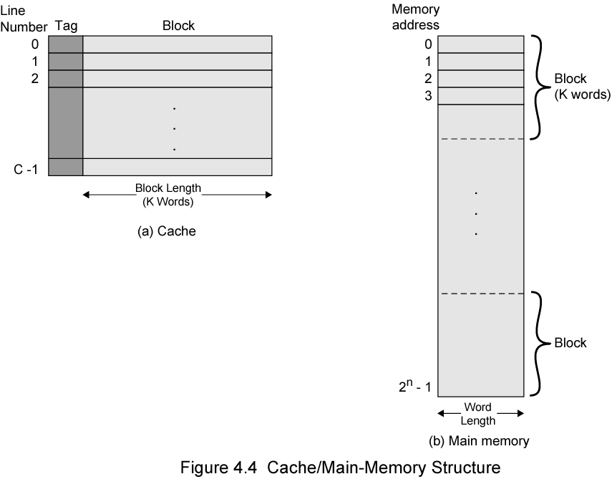

Cache/Main Memory Structure
Main memory consists of up to addressable words, with each word having a unique n-bit address.
For many purposes, this memory is considered to consist of a number of fixed-length blocks of K words each. That is, there are blocks.
The cache consists of C lines. Each line contains K words, plus a tag of a few bits; the number of words in the line is referred to as the line size.
The number of lines in cache is considerably less than the number of main memory blocks (C<<M).
If a word in a block of memory is read, that block is transferred to one of the lines of the cache.
As there are more blocks than lines, an individual line cannot be uniquely and permanently dedicated to a particular block. Thus, each line includes a tag that identifies which particular block is currently being stored.

Slide 11
Cache operation – overview
CPU requests contents of memory location
Check cache for this data
If present, get from cache (fast)
If not present, read required block from main memory to cache
Then deliver from cache to CPU
Cache includes tags to identify which block of main memory is in each cache slot

Slide 12
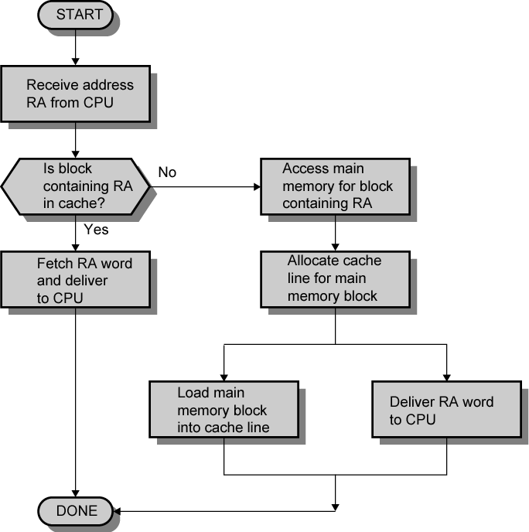
Cache Read Operation - Flowchart

Slide 13
Size does matter
Cost
  More cache is expensive
Speed
  More cache is faster (up to a point)
  Checking cache for data takes time

Slide 14

Typical Contemporary Cache Organization
The cache connects to the processor via data, control, and address lines.
The data and address lines also attach to data and address buffers which attach to a system bus from which main memory is reached.
When a cache hit occurs, the data and address buffers are disabled and communication is only between processor and cache.
When a cache miss occurs, the desired address is loaded onto the system bus and data are returned through the data buffer to both cache and processor.

Slide 15
Pentium 4 Cache
80386 – no on chip cache
80486 – includes single on-chip cache of 8 Kbytes, using 16 byte line size and four way set associative organization
Pentium (all versions) – two on chip L1 caches
  Data & instructions
Pentium III – L3 cache added off chip
Pentium 4
  L1 data cache is 8 Kbytes, line size of 64 bytes, and four way set associative organization
  L2 cache
    Feeding both L1 caches
    128 bytes line size
    8 way set associative
  L3 cache on chip

Slide 16
Pentium 4 Core Processor
Fetch/Decode Unit
  Fetches instructions from L2 cache
  Decode into a series of micro-operations
  Store micro-operations in L1 instruction cache
Out of order execution logic
  Schedules execution of micro-operations
  Subject to data dependencies and resources availability
  Thus, micro-operations may be scheduled in a different order than they fetched from instruction stream
  This unit schedules speculative execution of micro-operations that may be required in future
Execution units
  Execute micro-operations
  Fetching required data from L1 cache
  Results stored in registers temporarily
Memory subsystem
  This unit includes the L2 and L3 caches and the system bus which is used to access main memory when the L1 and L2 caches have a cache miss, and to access system I/O resources

Slide 17
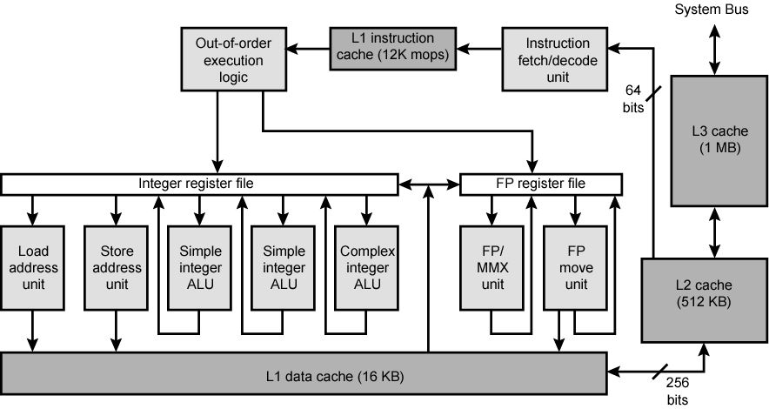
Pentium 4 Block Diagram

Slide 18
PowerPC Cache Organization – page 123
601 – single 32kb 8 way set associative
603 – 16kb (2 x 8kb) two way set associative
604 – 32kb
620 – 64kb
G3 & G4
  64kb L1 cache
    8 way set associative
  256k, 512k or 1M L2 cache
    two way set associative
G5
  32kB instruction cache
  64kB data cache

Slide 19
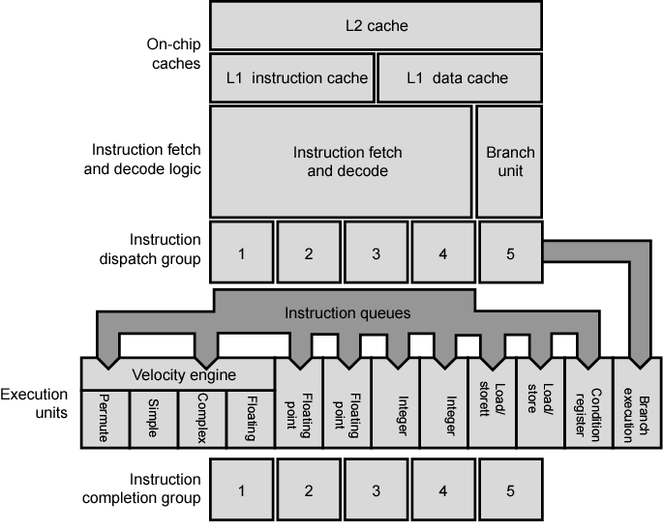
PowerPC G5 Block Diagram
The core execution group include two arithmetic and logic units, which can execute in parallel, and two floating point units with their own registers and each with its own multiply, add, divide components.
The instruction cache is read only, feeds into an instruction unit.
(Will be discussed later in Chapter 14)

Slide 20
Internal Memory

Slide 21
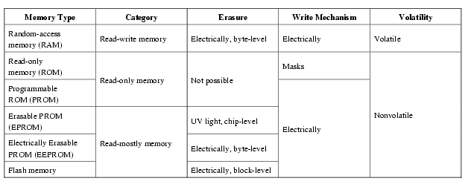
Semiconductor Memory Types

Slide 22
Semiconductor Memory
RAM
  Misnamed as all semiconductor memory is random access
  Read data from the memory and to write data into the memory easily and rapidly(through electrical signals)
  Volatile (if the power is interrupted, then the data are lost)
  Can be used as temporary storage
  Two traditional forms of RAM is Static or Dynamic (SRAM or DRAM)

Slide 23
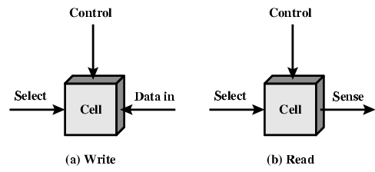
Memory Cell Operation
  Three terminals carry an electrical signal:
  Select terminal selects a memory cell for read and write operation
  The control terminal indicates read or write
  For writing, the other terminal provides an electrical signal that sets the state of the cell to 1 or 0.
  For reading, the terminal is used for output of the cell’s state.

Slide 24
Dynamic RAM
Made with cells that store data as charge on capacitors (the presence or absence of charge in a capacitor is interpreted as a binary 1 or 0)
The term dynamic refers to – the tendency of the stored charge to leak away
Capacitors have a natural tendency to discharge, dynamic RAMs need refreshing to maintain data storage
Simpler construction
Smaller per bit
Less expensive
Need refresh circuits
Slower
Main memory
Essentially analogue (although store a single bit 0 or 1)
  The capacitor can store any charge value within a range; a threshold value determines whether the charge is 0 or 1.

Slide 25
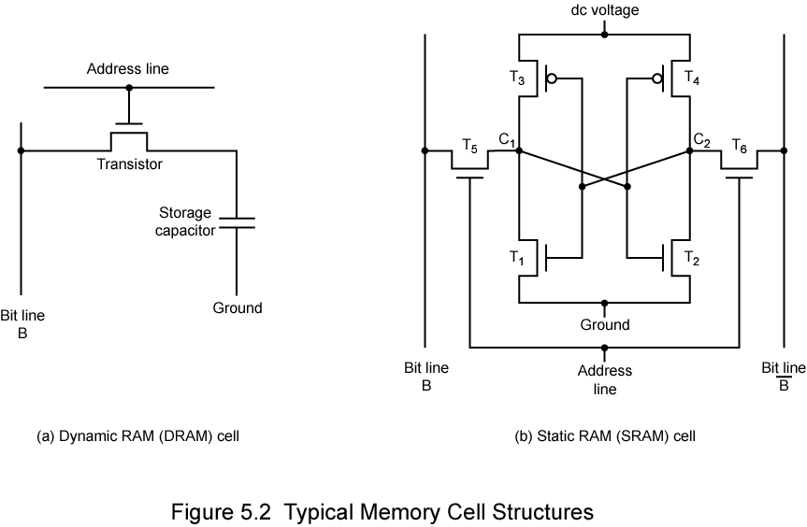
Dynamic RAM Structure & Operation
DRAM structure of an individual cell that stores one bit.
Address line active when bit from this cell is to be read or written
  Transistor acts a switch that is closed (allowing current to flow) if a voltage is applied to the address line and open (no current flows) if no voltage is present on the address line
Write
  A voltage signal applied to bit line
    High voltage→1, low voltage→0
  Then signal is applied to address line
    Transfers charge to capacitor
Read
  Address line is selected
    transistor turns on
  Charge from capacitor is fed out via bit line and to sense amplifier
  The read out form the cell discharges the capacitor, which must be restored to complete the operation

Slide 26
Static RAM
Bits stored as on/off switches
Holds data as long as power is supplied to it
No charges to leak
No refreshing needed when powered
More complex construction
Larger per bit
More expensive
Does not need refresh circuits
Faster
Cache
Digital device using the same logic elements in the processor
  Binary values are stored using flip-flop logic gate configuration.

Slide 27
Stating RAM Structure & Operation
For a SRAM individual cell, four transistors (T₁ ,T₂ ,T₃ ,T₄) are cross connected.
This arrangement gives stable logic state
State 1
  C₁ high, C₂ low
  T₁ T₄ off, T₂ T₃ on
State 0
  C₂ high, C₁ low
  T₂ T₃ off, T₁ T₄ on
SRAM address line is used to open or close a switch.
Address line controls two transistors T₅ and T₆
When a signal is applied to this line, the two transistors are switch on, allowing read and write operation.
Write – apply the bit value to B & compliment to B; this forces four transistors (T₁ ,T₂ ,T₃ ,T₄) into proper state.
Read – bit value is read from line B

Slide 28
SRAM v DRAM
Both volatile
  Power needed to preserve data
Dynamic cell
  Simpler, smaller than a static memory cell
  More dense (smaller cells=more cells per unit area)
  Less expensive
  Needs refresh circuitry
  Tends to be favoured for large memory requirements
Static
  Faster
  Cache

Slide 29
Read Only Memory (ROM)
Permanent storage (cannot be changed)
  Nonvolatile (no power source is required to maintain the bit values in memory)
  While it is possible to read a ROM, it is not possible to write new data into it
Important Application
Microprogramming (see later)
Library subroutines
Systems programs (BIOS)
Function tables
Advantage of ROM
Data or program is permanently in main memory and need never be loaded from a secondary storage device.

Slide 30
Types of ROM
Programmable read-only memory (PROM)
  Semiconductor memory whose contents may be set only once.
  The writing process is performed electrically and performed by the user at a time of original chip fabrication
  Needs special equipment to program
Read “mostly” – read operations are far more frequent than write operations but for which non-volatile storage is required
  Erasable Programmable (EPROM)
    Read and write electrically, as with PROM
    Before writing, all storage cells must be erased by ultraviolet (UV) radiation. [20 minutes take to erase]
    EPROM is more expensive than PROM but it has advantage of multiple update capability.
  Electrically Erasable (EEPROM)
    Can be written into anytime without erasing whole contents; only byte or bytes addressed are updated
    Takes much longer to write than read
    EEPROM has advantage of non-volatility with flexibility of being updatable
    More expensive than EPROM and also less dense (supporting fewer bits per cheap)
  Flash memory
    Erase whole memory or a section (block) electrically within one or a few seconds (in a single action or “flash”), which is much faster than EPROM

Slide 31
Organisation in detail
A 16-Mbit (4Mx4) chip can be organised as 1M of 16 bit words
4 bits are read and written at a time (four data lines are used for input and output of 4 bits to and from a data buffer).
A 16Mbit chip can be organised as a 2048 x 2048 x 4bit array
11 address lines are needed to select one of 2048 rows. These 11 lines are fed into row decoder, which has 11 lines of input and 2048 lines of output. The logic of the decoder activates one of the 2048 outputs depending on the bit pattern on the 11 input lines (2¹¹=2048)
Additional 11 address lines select one of 2048 columns of 4 bits per columns.
On input (write), the bit line is activated for a 1 or 0 according to the value of corresponding data line.
On output (read), the value of each bit line is passed through a sense amplifier and presented to the data lines.
The row line selects which row of cells is used for reading and writing
Reduces number of address pins
    Multiplex row address and column address (first, 11 address signals are passed to define the row address of the array, then other 11 are presented for column address)
    Signals are accompanied by RAS, CAS,WE, and OE.
    Adding one more pin doubles the number of rows and columns, so the size of memory grows by a factor of 4

Slide 32
Refreshing
All DRAM requires refresh operation
For refreshing, to disable the DRAM chip while all data cells are refreshed.
The refresh counter steps through all row values.
For each row, output lines from the refresh counter are supplied to the row decoder and RAS line is activated
The data are read out and written back into the same location; this causes each cell in the raw to be refreshed

Slide 33
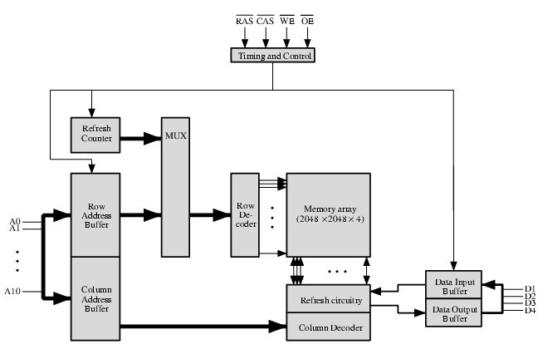
Typical 16 Mb DRAM (4M x 4)

Slide 34
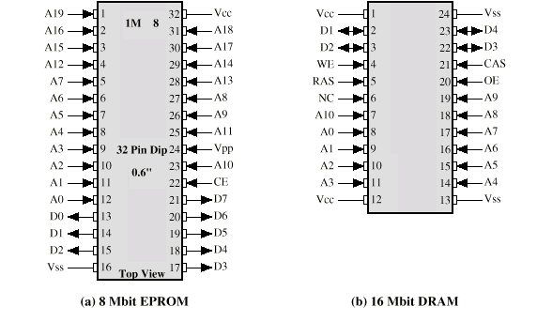
Packaging

Slide 35
Error Correction
Hard Failure
  Permanent defect
Soft Error
  Random, non-destructive
  No permanent damage to memory
Detected using Hamming error correcting code

Slide 36
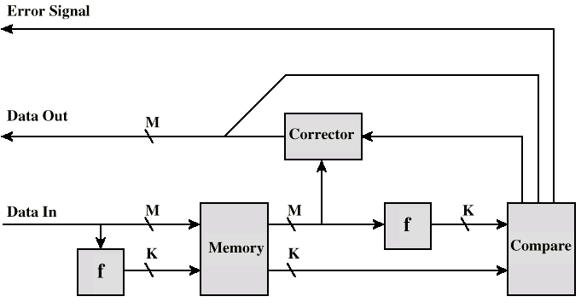
Error Correcting Code Function
When data are to be read into (stored) the memory, a function f is formed on the data to produce a code.
Both code and data are stored
Thus, if M-bit word of data is to be stored, and the code is of length K bits; actual size of the stored word is M+K bits
When stored word is read out, the code is used to detect and possibly correct errors.
A new set of K code bits is generated from M data bits and compared with the fetched code bits.
This comparison yields three results:
- No errors are detected and fetched data bits are sent out.
- An error is detected and possible to correct error. The data bits plus error correction bits are fed into a corrector, which produces M bits to be sent out.
- An error is detected, but it is not possible to correct it. This condition is reported.

Slide 37
Advanced DRAM Organization
Basic DRAM same since first RAM chips
Enhanced DRAM
  Contains small SRAM as well
  SRAM holds last line read (c.f. Cache!)
Cache DRAM
  Larger SRAM component
  Use as cache or serial buffer

Slide 38
Synchronous DRAM (SDRAM)
Access is synchronized with an external clock
Address is presented to RAM
RAM finds data (CPU waits in conventional DRAM)
Since SDRAM moves data in time with system clock, CPU knows when data will be ready
CPU does not have to wait, it can do something else
In burst mode, a series of data bits can be clocked out rapidly (on chip parallelism) after the first bit has been accessed.
DDR-SDRAM sends data twice per clock cycle (leading & trailing edge)

Slide 39
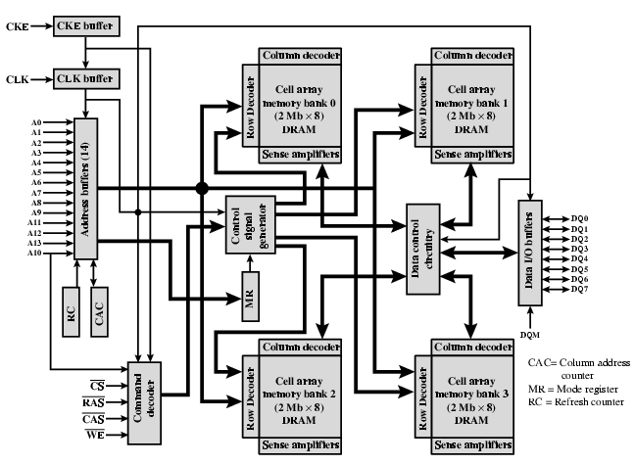
SDRAM

Slide 40
DDR SDRAM
SDRAM can only send data once per clock
Double-data-rate SDRAM can send data twice per clock cycle
  Rising edge and falling edge

Slide 41
Cache DRAM
Mitsubishi
Integrates small SRAM cache (16 kb) onto generic DRAM chip
Used as true cache
  64-bit lines
  Effective for ordinary random access
To support serial access of block of data
  E.g. refresh bit-mapped screen
    CDRAM can prefetch data from DRAM into SRAM buffer
    Subsequent accesses solely to SRAM

